Slide 1

SMART MUSIC PLAYER INTEGRATING FACIAL EMOTION RECOGNITION
(MOODY)
Guided by :
Mr. Chetan Chauhan
Assistant Professor
SVIIT , SVVV
Submitted by :
Hritik Maheshwari (16010BTCS00390)
Ishrak Khan(16010BTCS00389)
Vrashabh Paliwal(16010BTCS00370)

Slide 2

Content
Introduction
Problem Statement
Literature Survey
Objective
Proposed Solution
UML Diagrams
Implementation
Conclusion
Limitation of Project
Future Scope
References

Slide 3
Introduction
Current research in the field of music psychology has shown that music induces a clear emotional response in its listeners . Musical preferences have been demonstrated to be highly correlated with personality traits and moods.
Undoubtedly, a user’s affective response to a music fragment depends on a large set of external factors, such as gender, age , culture, personal preferences, emotion and context (e.g. time of day or location). However, these external variables set aside, humans are able to consistently categorize songs as being happy, sad, enthusiastic or relaxed.

Slide 4
Problem Statement
Currently, there are no dedicated applications to suggest songs based on emotion of music listeners. There are also very few applications that focus on the user preferences and recommendations, and these are not customizable .
Music listeners have tough time creating and segregating the play-list manually when they have hundreds of songs. It is also difficult to keep track of all the songs: sometimes songs that are added and never used, wasting a lot of device memory and forcing the user to find and delete songs manually. User’s have to manually select songs every time based on interest and mood.

Slide 5



Literature Survey
Currently, there are no dedicated applications to suggest songs based on emotion of music listeners. There are also very few applications that focus on the user preferences and recommendations, and these are not customizable, like Moody. Other applications suggests predefined (not user-specific) song play-lists. Application like :-
Saavan and Spotify – These application gives good user accessibility features to play songs and recommends user with other songs of similar genre.
Moodfuse - In this application , user should manually enter mood and genre that wants to be heard and moodfuse recommends the songs-list.

Slide 6
Comparative Study
Application features | Spotify | Saavn | Wynk | Moody
Platforms | Android Ios | Android ios | Android ios | Android
Themes | Less choices available | Can’t change theme | Can’t change theme | Comparatively more themes available
Songs language | 12+ languages available | 12+ language available | 7+ language available | 12+ languages
Subscription | INR - 399 for gaana+ subscription | Free for jio users only(biased) | For airtel users – INR 29 per month Non-airtel users – INR 99 /month(biased) | Free Subscription

Slide 7
Comparative Study cont…
Application features | Spotify | Saavn | Wynk | Moody
Playlist creation | yes | yes | no | yes
Download Songs | Gaana+ subscription required | (biased)Jio user can download free | (biased)Airtel user can download free | Anyone can download free
Lyrics | Available | Not available | Not available | Available
Night mode | yes | yes | no | yes
Buffer time | Take time for hd quality | Take less time | Take time | Comparatively take less time

Slide 8
Comparative Study cont…
Application features | Spotify | Saavn | Wynk | Moody
Recommendation on user preference | Yes | Yes | No | Yes
Recommendation by facial emotions recognition | No | No | No | Yes

Slide 9
Objective
The main objective is to design a cost-effective music player which automatically generates a sentiment aware playlist based on the emotional state of the user.

Slide 10
Proposed Solution
The application is designed to consume minimal system resources. The emotion module determines the emotion of the user. Relevant and critical audio information from a song is extracted by the music classification module. The recommendation module combines the results of the emotion module and the music classification module to recommend songs to the user. This system provides significantly better accuracy and performance than existing systems.

Slide 11
UML Diagrams

Slide 12
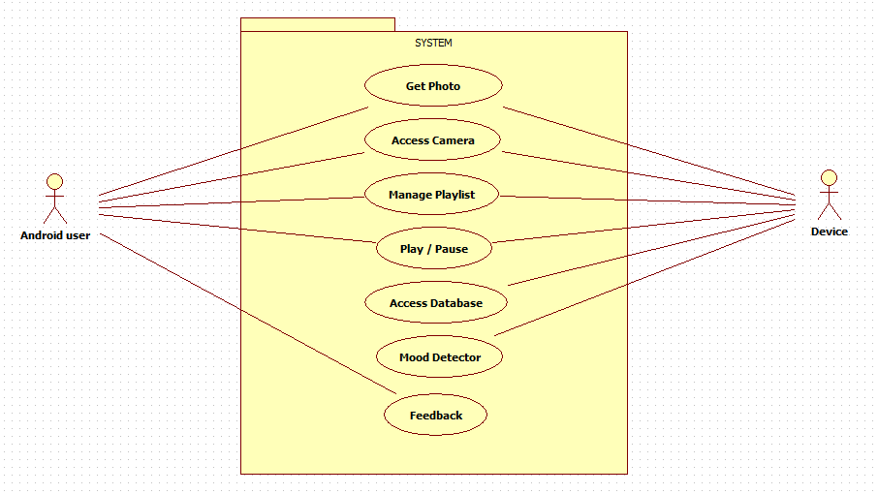
Use Case Diagram
Fig 1 : Use Case Diagram

Slide 13
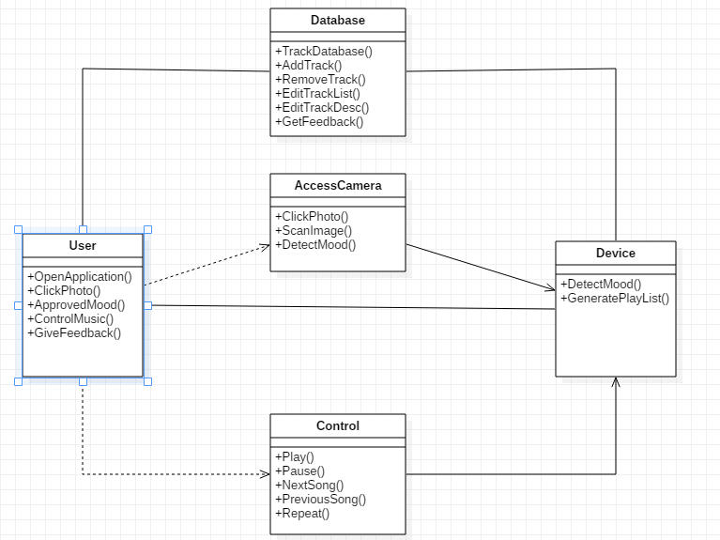
Class Diagram
Fig 2 : Class Diagram

Slide 14
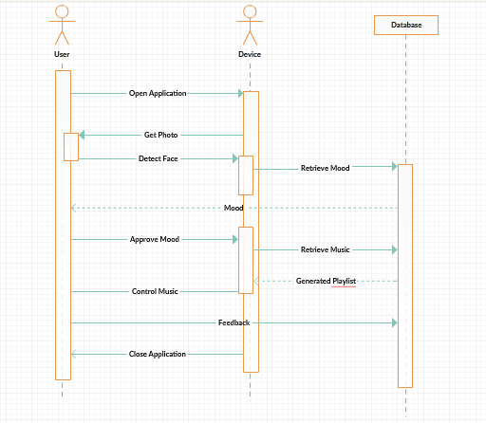
Sequence Diagram
Fig 3 : Sequence Diagram

Slide 15
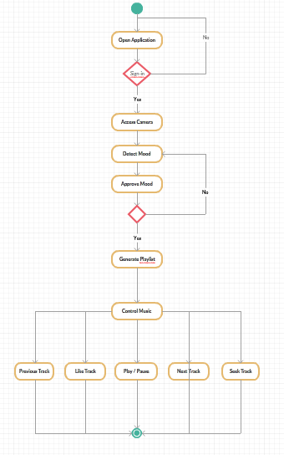
Activity Diagram
Fig 4 : Activity Diagram

Slide 16
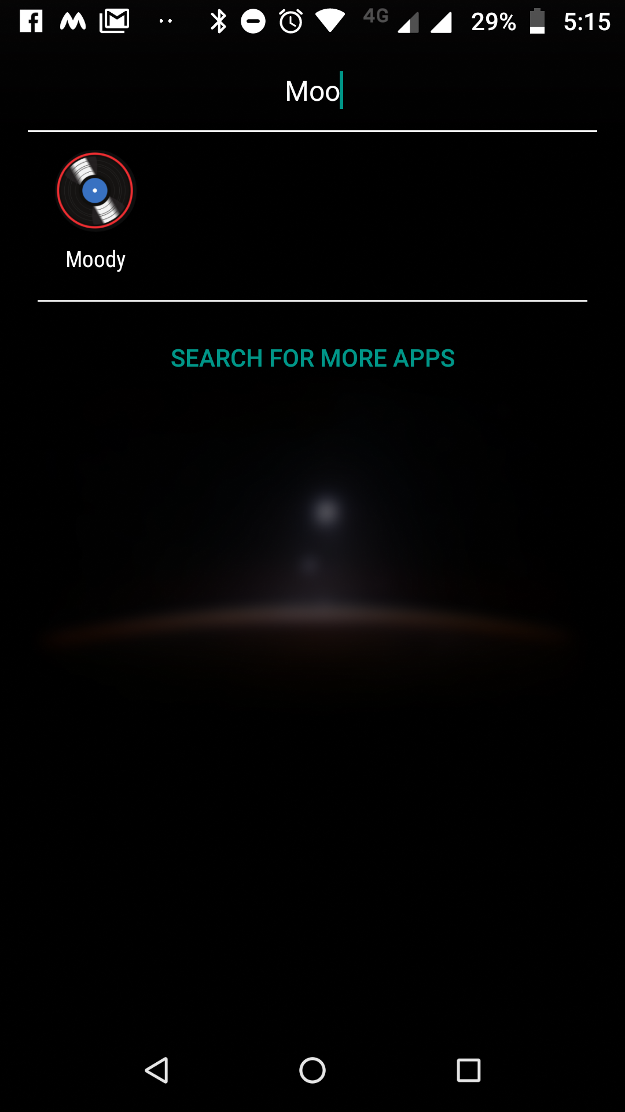
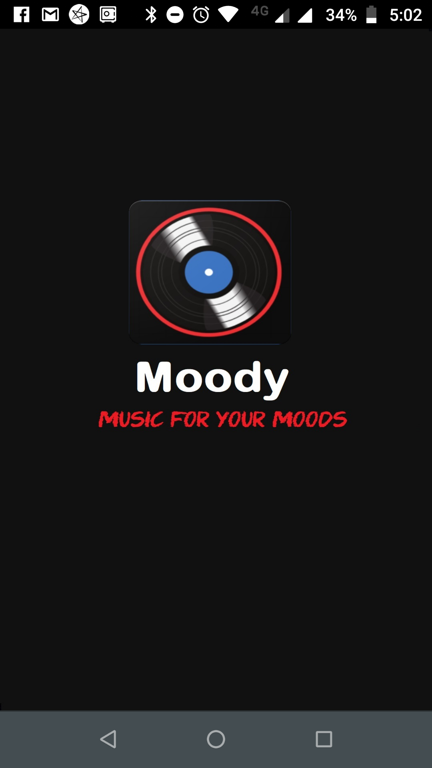
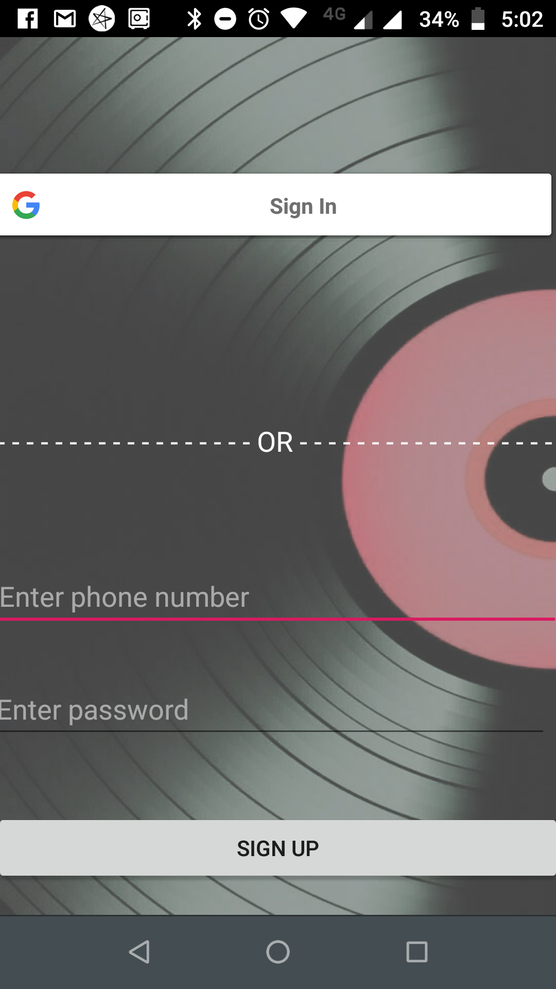
Implementation
Application Icon
Launcher screen
Sign In with Google

Slide 17
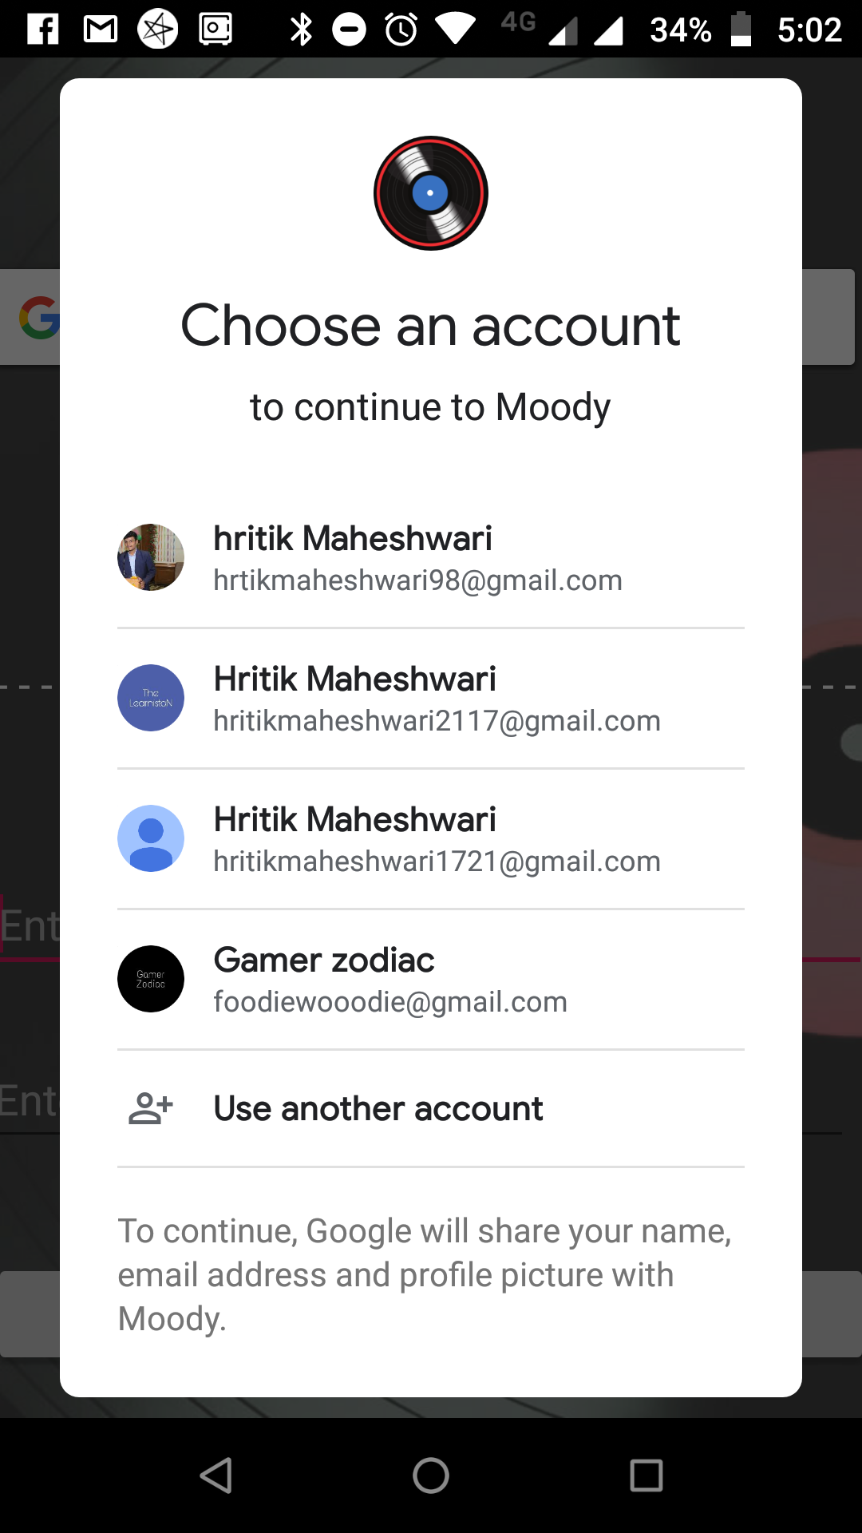
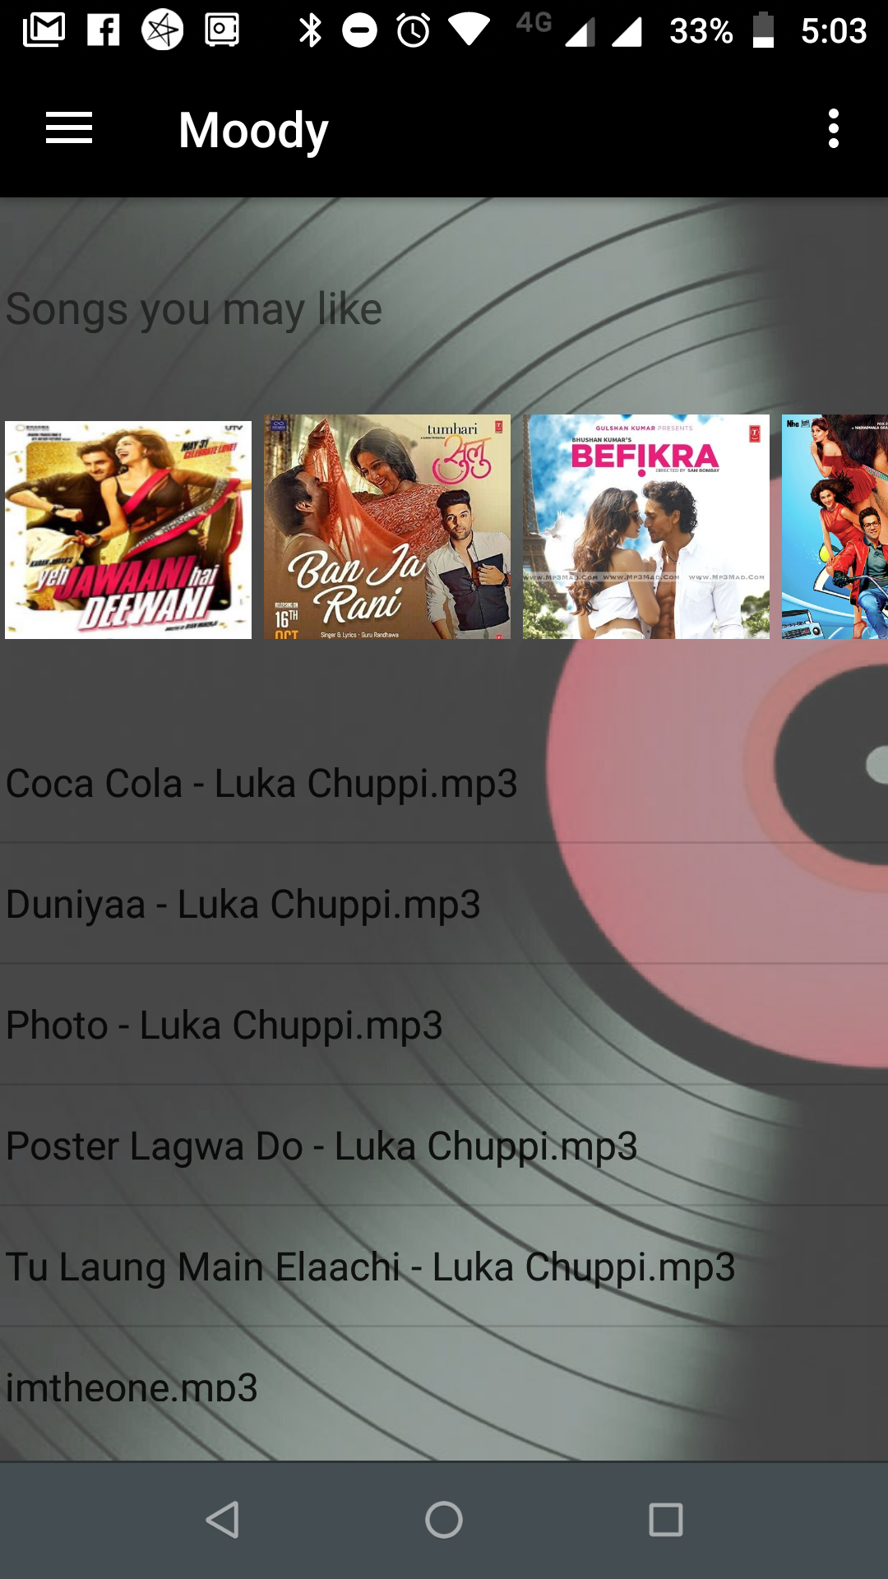
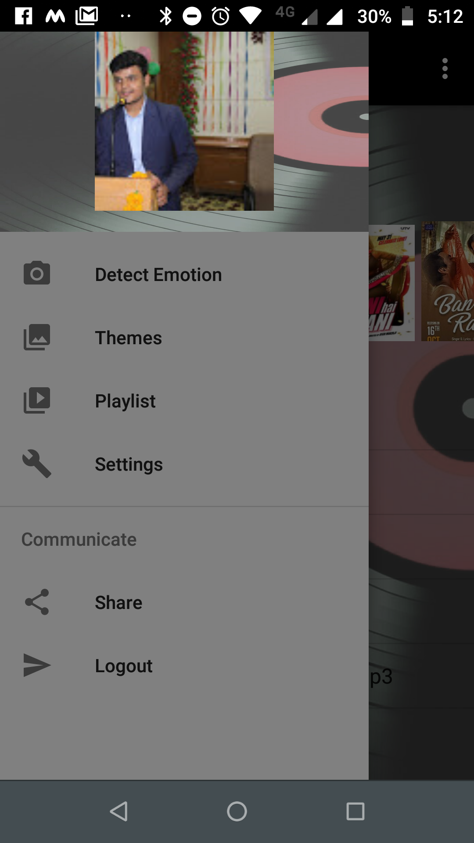
Choose an account
Home Screen
Navigation Bar

Slide 18
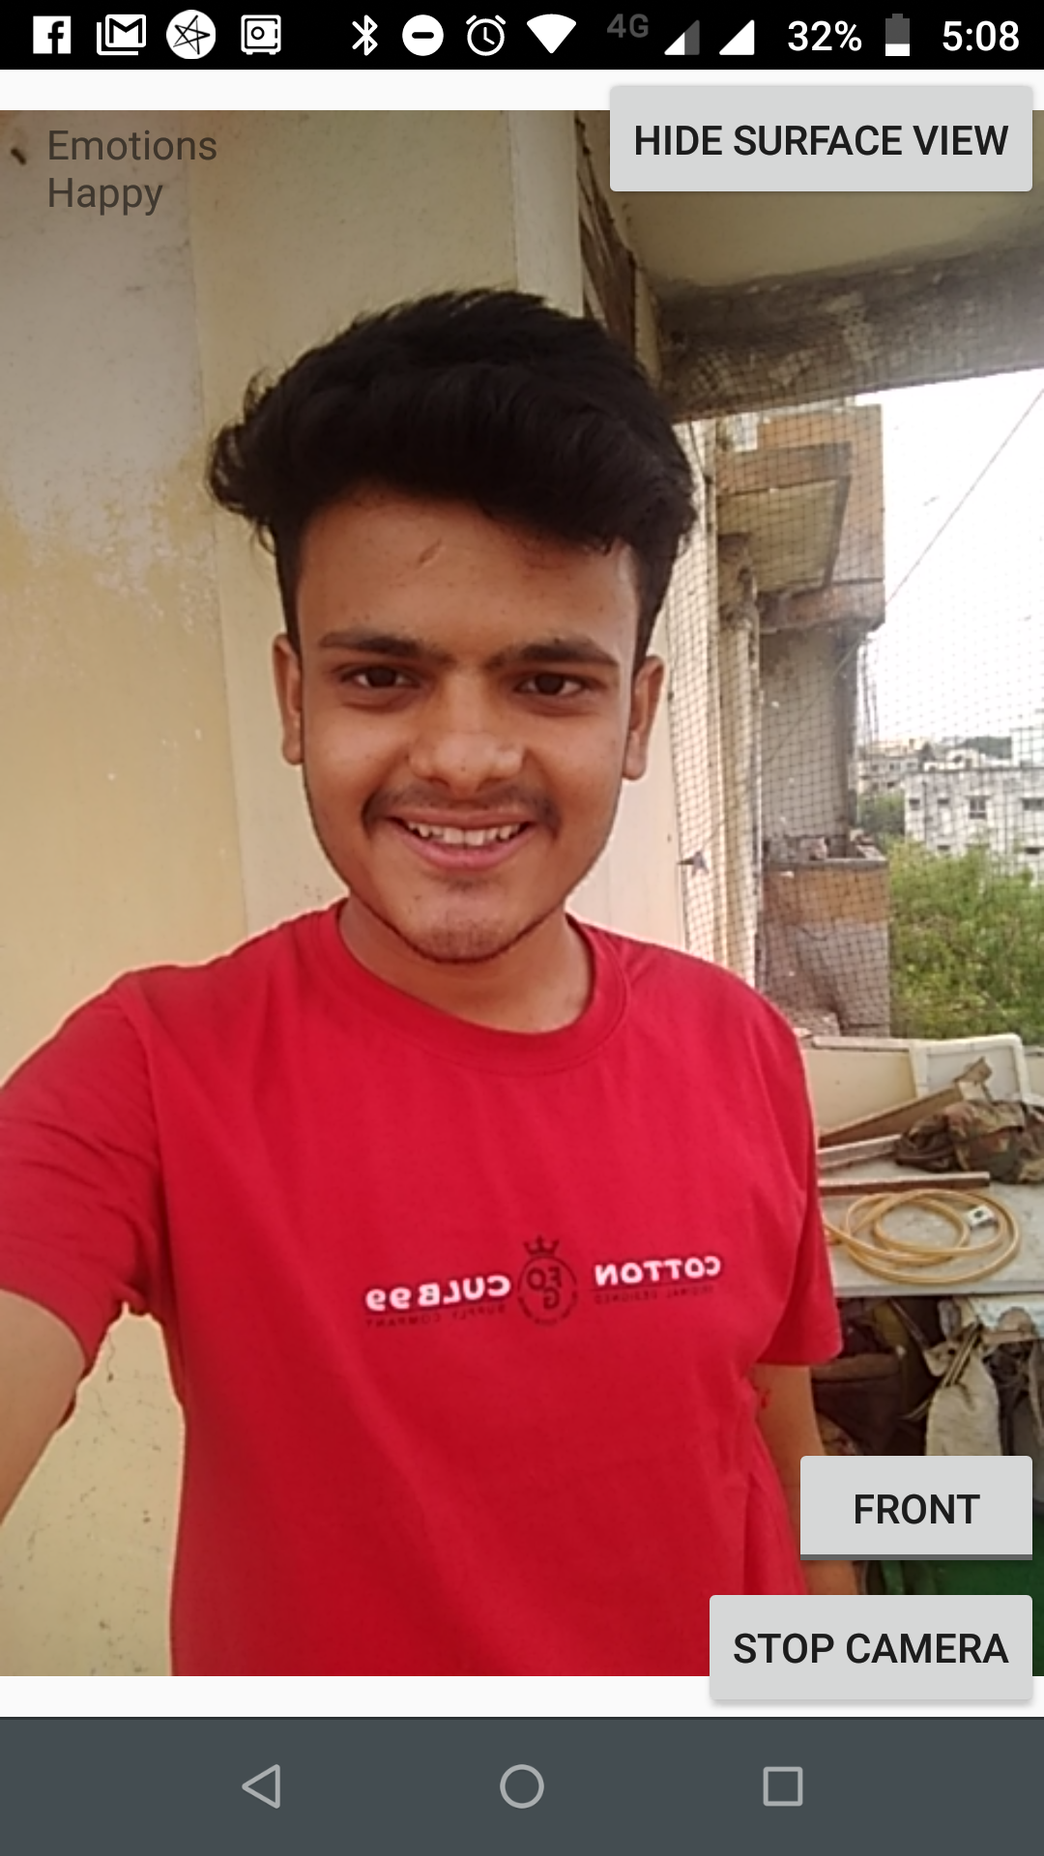
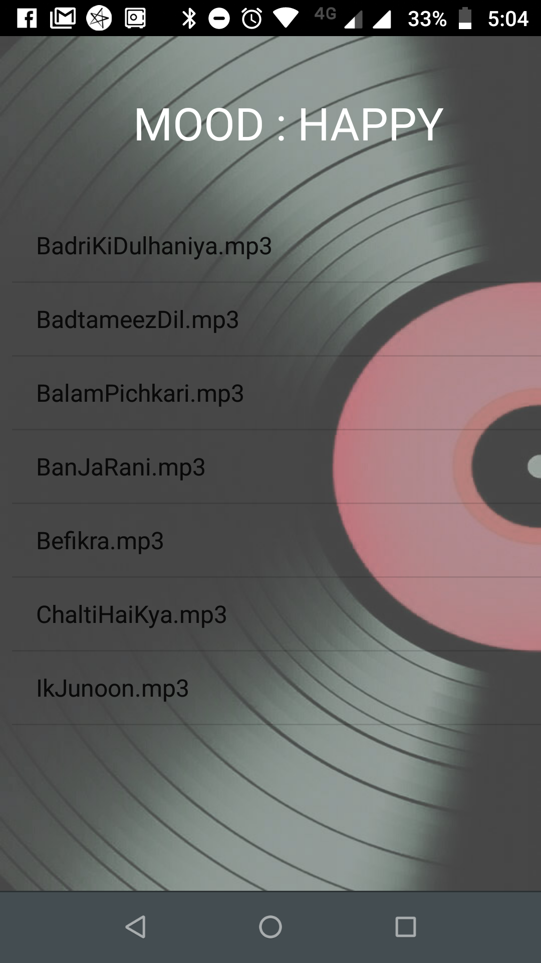
Mood Detector
Playlist Generation

Slide 19
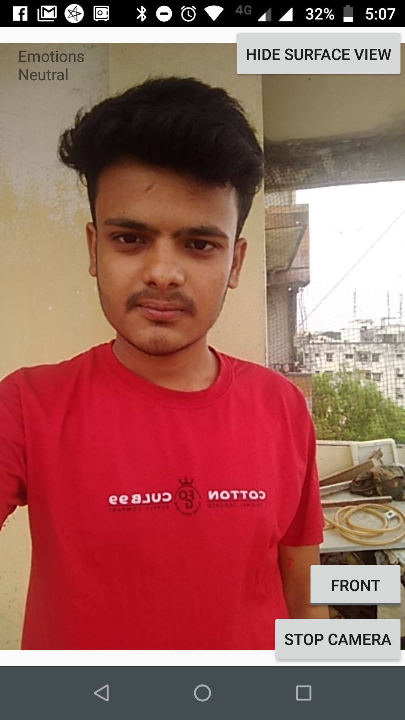
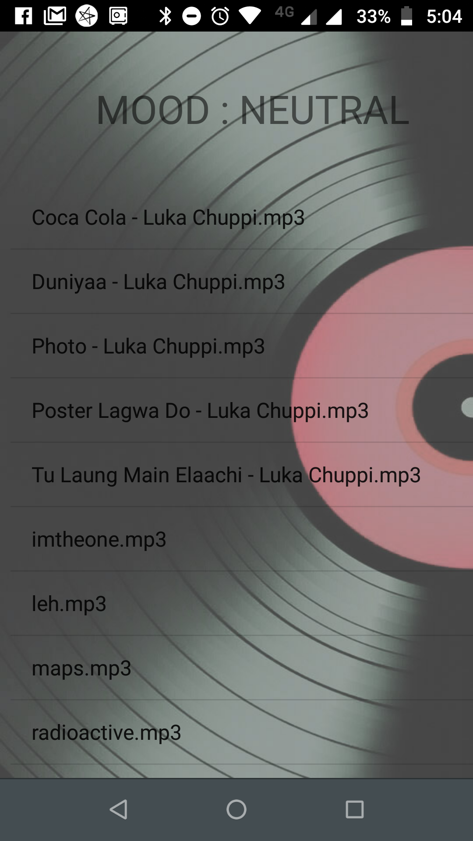
Mood Detector
Playlist Generation

Slide 20
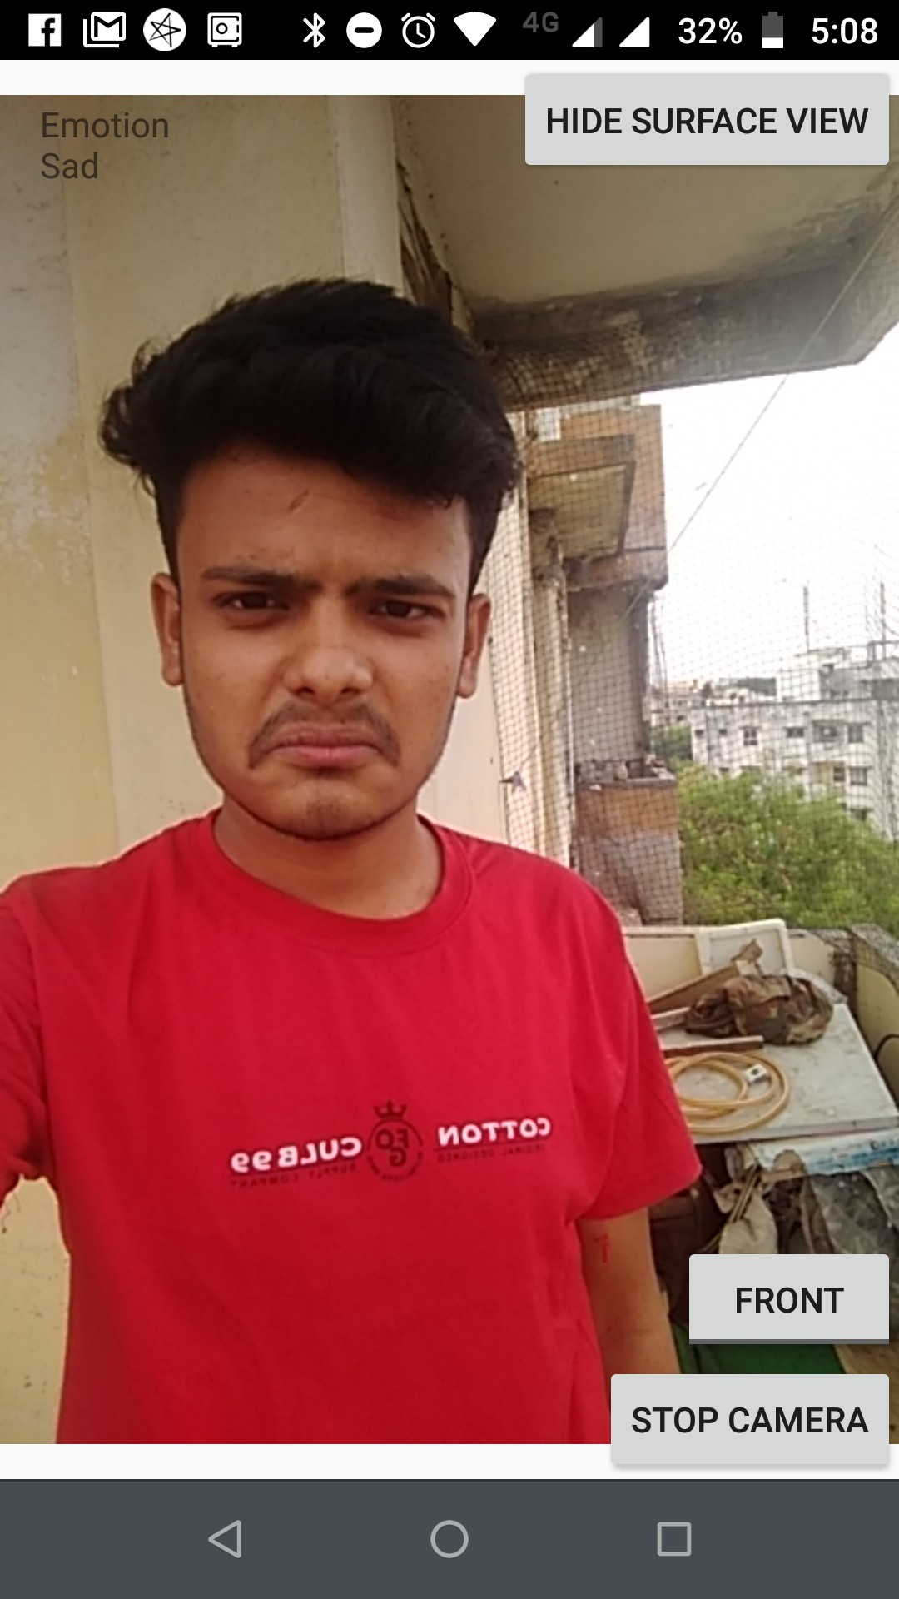
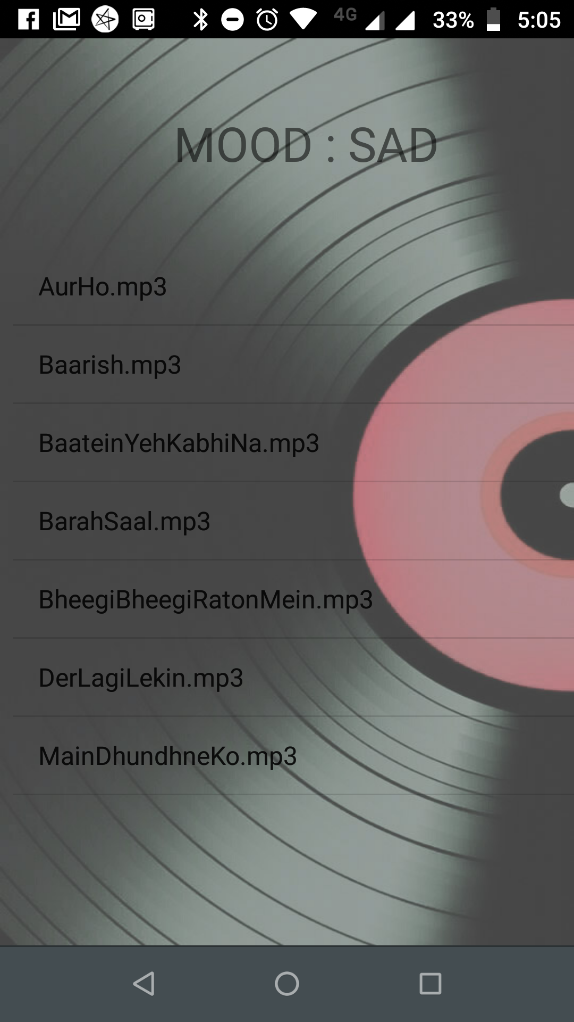
Mood Detector
Playlist Generation

Slide 21
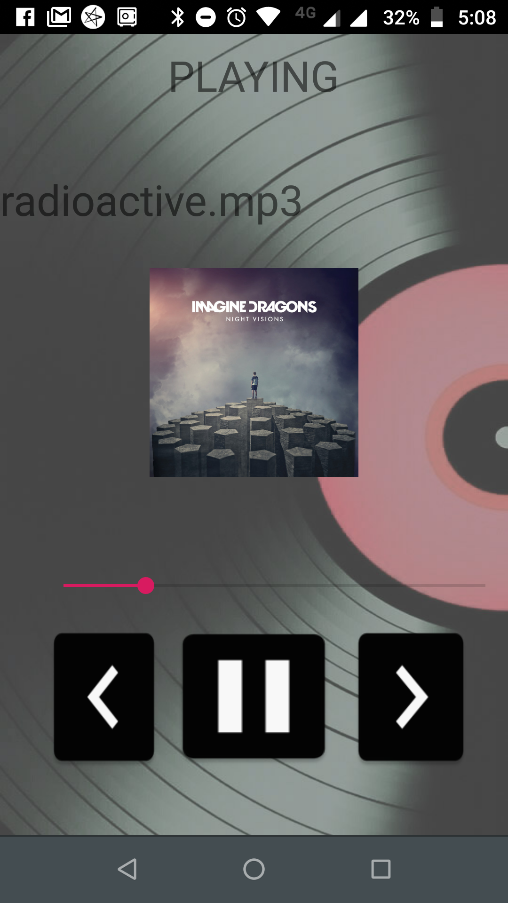
Play Screen

Slide 22
Conclusion
The Emotion-Based Music Player(Moody) is used to automate and give a better music player experience for the end user. The application solves the basic needs of music listeners without troubling them as existing applications do: it uses technology to increase the interaction of the system with the user in many ways. It eases the work of the end-user by capturing the emotion using a camera , and suggesting a customized play-list through a more advanced and interactive system..

Slide 23
Limitation of Project
Require good camera quality.
Internet connectivity

Slide 24
Future Enhancement
The future scope in the system would to design a mechanism that would be helpful in categorizing songs on the basis of emotions as well as on the basis of age.
Making the application run without needing internet connection.
Including other emotions.
Playing songs automatically.

Slide 25
References
Shlok Gilda, Husain Zafar, Chintan Soni and Kshitija Waghurdekar – “Smart Music Player Integrating Facial Emotion Recognition and Music Mood Recommendation”,IEEE WiSPNET conference 2017

